Slide 1


SQL Server Introduction
Creating And Managing Indexing

Slide 2
SQL Server Introduction
Creating and Managing Indexes
SQL Server allows you to create indexes on a table.
Indexes help in accessing data from the tables in the least possible time.

Slide 3
SQL Server Introduction
Identifying the Types of Indexes
An index:
Is a data structure that enables fast searching of data.
Accelerates queries that join tables, and performs sorting and grouping.
Enforces uniqueness of rows (if configured for that).
Contains a collection of keys and pointers.

Slide 4
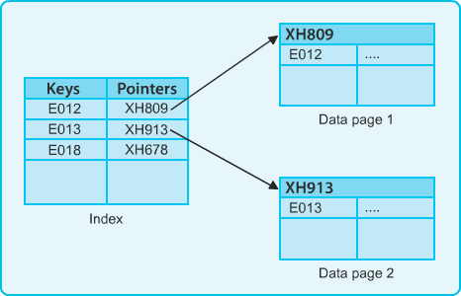
SQL Server Introduction
Identifying the Types of Indexes (Contd.)
Keys are the values built on the frequently searched column or columns of the table.
Pointers store the address of the location where a data page is stored in the memory, as depicted in the following figure.

Slide 5
SQL Server Introduction
Identifying the Types of Indexes (Contd.)
Indexes are of the following types:
Clustered
Non clustered
A Table can contain Maximum only 1 Clustered Index and more than one non clustered index on different columns within it.

Slide 6
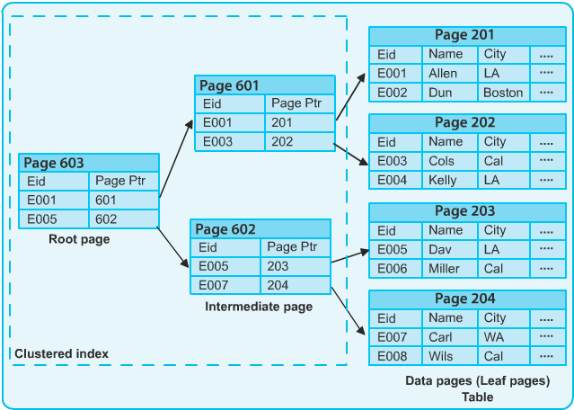
SQL Server Introduction
Identifying the Types of Indexes (Contd.)
A clustered index sorts and stores the data rows in the table based on their key values, as shown in the following figure.

Slide 7
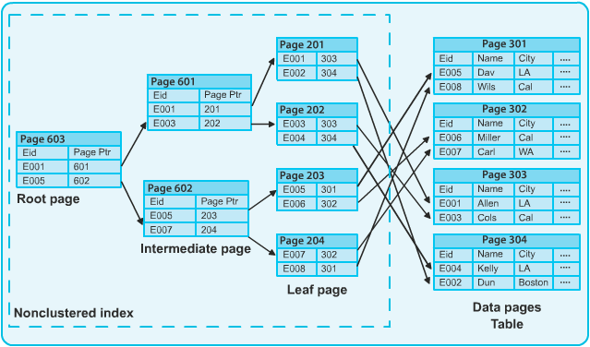
SQL Server Introduction
Identifying the Types of Indexes (Contd.)
A non clustered index does not have the same physical order of the rows as the index order, as shown in the following figure.

Slide 8
SQL Server Introduction
Creating Indexes
An index:
Is created on the most frequently queried column of the tables or views. Based on two or more columns is called a composite index.
Can be created by using the CREATE INDEX statement.

Slide 9
SQL Server Introduction
Creating Indexes (Contd.)
Syntax:
CREATE [UNIQUE][CLUSTERED | NONCLUSTERED] INDEX index_name
ON [{database_name.[schema_name]. | schema_name.}]
{table_or_view_name}(column [ASC | DESC][,...n]) [WITH(<relational_index_option>[,...n])]
[ON {partition_scheme_name(column_name[,...n])
| filegroup_name | DEFAULT}]
<relation_index_option>::=
{PAD_INDEX = {ON | OFF}
| FILLFACTOR = fillfactor
| ONLINE = {ON | OFF}

Slide 10
SQL Server Introduction
Creating Indexes
Consider the following guidelines while creating indexes on a table:
Create clustered indexes on columns that have unique or not null values. Do not create an index that is not used frequently. You require time and resources to maintain indexes.
Create a clustered index before creating a non clustered index. A clustered index changes the order of rows. A non clustered index would need to be rebuilt if it is built before a clustered index.
Create non clustered indexes on all the columns that are frequently used in predicates and join conditions in queries.

Slide 11
SQL Server Introduction
Creating Indexes
A filtered index:
Allows you to create an index on the specific rows of a table rather than the entire table.
Helps in reducing the index storage space and maintenance costs as compared to
full-table indexes.
Can be created based on a condition specified by the WHERE clause. For example:
CREATE NONCLUSTERED INDEX FX_EmployeeID
ON HumanResources.Employee(EmployeeID) WHERE Title= 'Tool Manager'
Creates a filtered index for those records in the Employee table, where the value in the Title column is Tool Manager.

Slide 12
SQL Server Introduction
Managing Indexes
The common index maintenance tasks include:
Disabling indexes
Enabling indexes
Renaming indexes
Dropping indexes
Optimizing indexes [ This Topic will be Discussed During Performance Optimization]

Slide 13
SQL Server Introduction
Managing Indexes
Disabling indexes:
When an index is disabled, the user is not able to access the index.
If a clustered index is disabled, then the table data is not accessible to the user.
For example:
ALTER INDEX Myindex
ON Price DISABLE
Disables a clustered index, MyIndex.
Have You Ever Thought what will happen if the Index is not existing at all ?

Slide 14
SQL Server Introduction
Managing Indexes
Enabling indexes:
Can be achieved by one of the following methods:
Using the ALTER INDEX statement with the REBUILD clause
Using the CREATE INDEX statement with the DROP_EXISTING clause
For example:
ALTER INDEX IX_EmployeeID ON Employee REBUILD
Rebuilds the clustered index on the Employee table.

Slide 15
SQL Server Introduction
Renaming An Indexes
Indexes can be renamed using the sp_rename system stored procedure. Indexes can be dropped using the DROP INDEX statement.

Slide 16
SQL Server Introduction
Optimizing Indexes
Optimizing indexes:
Large number of insert and update operations on a table result in fragmentation. Fragmentation exists when indexes have pages where the logical ordering does not match the physical ordering within the data file.
This affects the performance of the query.
Therefore, index defragmentation can be done by either reorganizing or rebuilding an index.
This Topic will be Further Discussed During Performance Optimization

Slide 17
SQL Server Introduction
Creating And Managing Views
In this session, you will learn to: Create and manage views Working of a View
A database administrator can restrict access of data to different users by using views. A view:
Is a virtual table.
Is only a query stored as an object in the Database
Derives its data from one or more base tables.
Provides access to a subset of columns from one or more tables.

Slide 18
SQL Server Introduction
Creating And Managing Views
A view ensures security of data by restricting access to:
Specific rows of a table.
Specific columns of a table.
Specific rows and columns of a table. Rows fetched by using joins.
Statistical summary of data in a given table.
Subsets of another view or a subset of views and tables.
A view is created by using the CREATE VIEW statement. Syntax:
CREATE VIEW view_name [(column_name [, column_name]...)] [WITH ENCRYPTION [, SCHEMABINDING]]
AS select_statement [WITH CHECK OPTION]

Slide 19
SQL Server Introduction
Creating And Managing Views
Data in the base tables can be modified using views:
If the modification does not affect more than one underlying table.
If the modification does not involve a column that is the result of a calculation.
Management of views include:
Altering views
Renaming views
Dropping views

Slide 20
SQL Server Introduction
Creating And Managing Views
Altering views:
To modify a view, you need to use the ALTER VIEW statement. Syntax:
ALTER VIEW view_name [(column_name)] [WITH ENCRYPTION]AS select_statement [WITH CHECK OPTION]
Renaming views:
A view can be renamed by using the sp_rename procedure. Syntax:
sp_rename old_viewname, new_viewname
Dropping views:
A view can be dropped by using the DROP VIEW statement.
Syntax: DROP VIEW view_name

Slide 21
SQL Server Introduction
Creating And Managing Views
You can create indexes on views when the volume of data in the underlying tables is large and not frequently updated.
Indexing a view helps in improving the query performance. Guidelines for creating an indexed view:
A unique clustered index must be the first index to be created on a view.
The view must not reference any other views. It can reference only base tables. All base tables referenced by the view must be in the same database and have the same owner as the view.
The view must be created with the SCHEMABINDING option.
The view must not contain keywords like MIN, MAX, TOP, UNION, DISTINCT, COUNT, FULLTEXT, and CONTAINS.

Slide 22
SQL Server Introduction
Lab Exercise
Create A View using Books Table so that we can see the detail of Books whose price is in between 500 to 1000.
Create a Non Clustered index on Publisher and later create a view to see the List of Book Published by BPB.
Try to rename the View that you have created just now.
Using Object Explorer try to figure out the tables, Views and indexes within the database.
What will be the appropriate SQL Command to see the structure of the table Distributor.

Slide 23
SQL Server Introduction
Stored Procedure

Slide 24
SQL Server Introduction
Implementing Stored Procedures
A stored procedure is a precompiled object stored in the database. The batches that need repeated execution can be saved within a stored procedure.

Slide 25
SQL Server Introduction
Creating Stored Procedures
A stored procedure is created using the CREATE PROCEDURE
statement.
Syntax:
CREATE PROCEDURE proc_name AS
BEGIN
sql_statement1 sql_statement2
END
Stored procedures are executed using the EXECUTE statement. Syntax:
EXEC | EXECUTE proc_name
Trainer Will Give Suitable Demo During Training Session

Slide 26
SQL Server Introduction
Creating Stored Procedures (Contd.)
Altering a stored procedure:
A stored procedure is modified using the ALTER PROCEDURE statement. Syntax:
ALTER PROCEDURE proc_name
Dropping a stored procedure:
A stored procedure is deleted using the DROP PROCEDURE statement. Syntax:
DROP PROCEDURE proc_name

Slide 27
SQL Server Introduction
Creating Parameterized Stored Procedures
Parameters:
Are used to pass values to the stored procedures during run time. Have a name, data type, direction, and may be a default value.
Creating a parameterized stored procedure:
CREATE PROC prcListEmployee @title char(50) AS
BEGIN
....
END
Executing the parameterized stored procedure: EXECUTE prcListEmployee 'Tool Designer'

Slide 28
SQL Server Introduction
Returning Values from Stored Procedures
You can return values from the stored procedure by using the:
RETURN statement OUTPUT parameters
The RETURN statement allows the stored procedure to return only an integer value to the calling application.
Syntax:
RETURN value

Slide 29
SQL Server Introduction
Returning Values from Stored Procedures (Contd.)
The OUTPUT keyword allows you to create a stored procedure with output parameters.
Syntax:
CREATE PROCEDURE procedure_name (
{@parameter data_type} [OUTPUT]
)
AS
sql_statement [...n]

Slide 30
SQL Server Introduction
Lab Exercise
Create a Procedure which can accept a Date as a parameter and shows the List of Books which were published on or after that date.
Create a Procedure which can accept a BookName as a parameter. If it exists then it should show the entire detail for that Book otherwise it should show appropriate Message so that user can understand that the book does not exist.

Slide 31
SQL Server Introduction
End of Day 3

